Slide 1


The Impact of School Enrollment on Economic Growth
Bayanmunkh Delgersaikhan
Tuguldur Bayartulga
Tenuun Erdenesugar
Python for Data science and AI
Hamza Rafik
2024.10.14

Slide 2
Hypothesis-1 & Research question
Hypothesis-1:
Countries with higher primary school enrollment rates experience faster GDP growth than those with lower enrollment rates.
Research Question:
What is the relationship between primary school enrollment rates and GDP growth in developing countries?

Slide 3


Retrieving Data
API: Nasdaq - World Bank Dataset

Slide 4
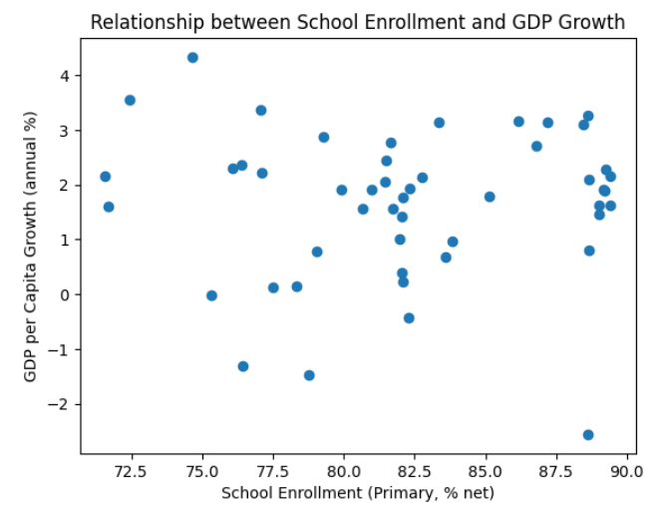
Relationship between Primary School Enrollment and GDP Growth
The scatter plot shows some relationship between primary school enrollment and GDP per capita growth, though it seems somewhat dispersed, meaning the relationship might not be very strong.

Slide 5
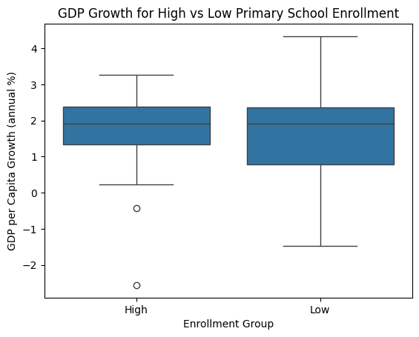
Relationship between Primary School Enrollment and GDP Growth
The box plot suggests that primary school enrollment rates alone do not strongly differentiate GDP growth across countries.
Both high and low enrollment countries can achieve similar levels of GDP growth, with the low enrollment group showing more variability.

Slide 6

Testing Our Hypothesis Using t-test

Slide 7
Conclusion: Hypothesis-1
Hypothesis-1:
Countries with higher primary school enrollment rates experience faster GDP growth than those with lower enrollment rates.
The difference in GDP growth between primary school enrollment countries is not significant.
School enrollment alone may not be a strong predictor of GDP growth.
Other economic, social, or political factors could be playing a larger role.
Worth exploring other variables.

Slide 8
Hypothesis-2 & Research question
Hypothesis-2:
Countries with higher secondary school enrollment rates experience faster GDP growth than those with lower enrollment rates.
Research Question:
What is the relationship between secondary school enrollment rates and GDP growth in developing countries?

Slide 9
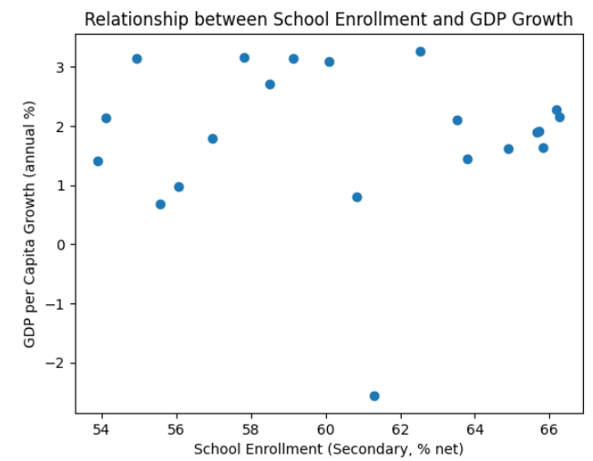
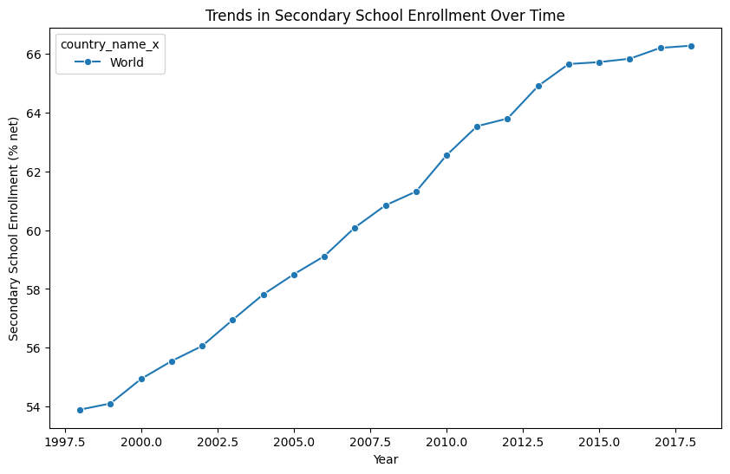
Relationship between Secondary School Enrollment and GDP Growth
scatterplot
lineplot
Indicates a weak or unclear relationship between the two variables.
The global trend in secondary school enrollment shows a consistent improvement, reflecting efforts in many countries to expand access to secondary education.

Slide 10

Testing our hypothesis using t-test

Slide 11
Conclusion: Hypothesis-2
Hypothesis-2:
Countries with higher secondary school enrollment rates experience faster GDP growth than those with lower enrollment rates.
Both primary and secondary school enrollment rates do not show a statistically significant impact on GDP growth.
The relationship with economic growth may depend on additional variables or conditions.

Slide 12
Hypothesis-3 & Research question
Hypothesis-3:
School enrollment rates on GDP growth differ across countries at different stages of development, with lower-income countries (e.g., Haiti) experiencing a stronger positive effect compared to middle-income countries (e.g., India) and high-income countries (e.g., the United States)
Research question:
Is there any relationship between school enrollment rates and GDP growth, across countries at different stages of development?

Slide 13
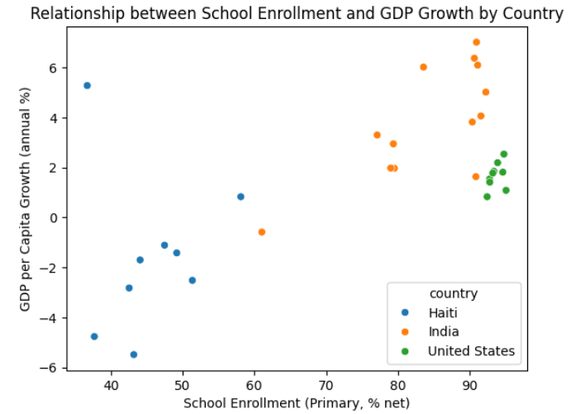
Scatterplot: School Enrollment and GDP Growth By Country

Slide 14
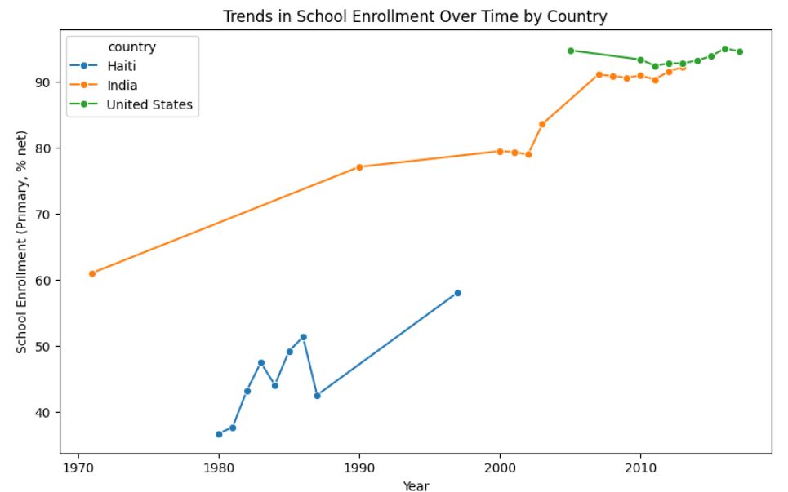
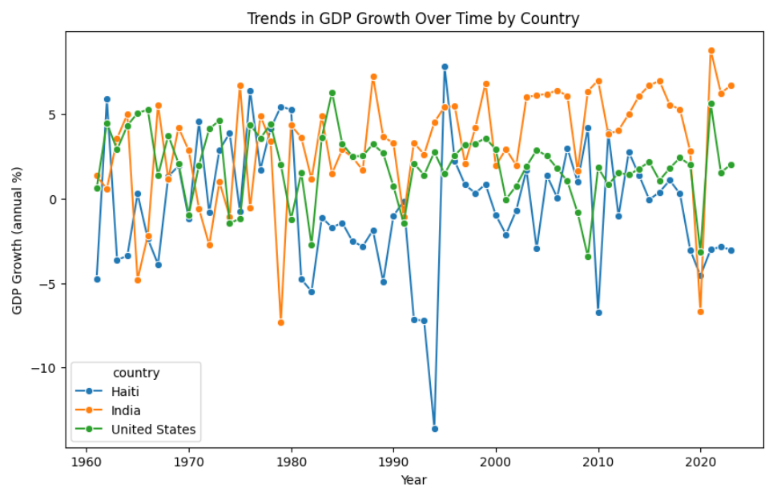
School Enrollment & GDP Growth over time

Slide 15
Testing our hypothesis using t-test
Haiti: T-Test: 0.3745 P-Value: 0.7192
A very small difference between the two groups.
The difference is not statistically significant.
No meaningful impact on GDP growth.
India: T-Test: 2.0298 P-Value: 0.0673
A moderate difference in GDP growth between countries with high and low school enrollment rates.
The difference is marginally insignificant.
A potential relationship between school enrollment and GDP growth, but it’s not strong enough at the 95% confidence level.
United States: T-Test: 1.2424 P-Value: 0.2541
A small difference between the two groups.
The difference is not statistically significant.
Other factors might be playing a larger role in driving economic growth.

Slide 16
Conclusion: Hypothesis-3
Hypothesis-3:
School enrollment rates on GDP growth differ across countries at different stages of development, with lower-income countries (e.g., Haiti) experiencing a stronger positive effect compared to middle-income countries (e.g., India) and high-income countries (e.g., the United States)
Haiti and the United States show no significant relationship between school enrollment and GDP growth
Other factors are likely influencing their economies.
In Haiti's case, low school enrollment and other development challenges could dilute the effect of education on economic growth.
India shows a potential but not statistically significant relationship.
Suggests that the impact of education on growth is more noticeable in middle-income countries.

Slide 17
CONCLUSION
Our findings show that school enrollment rates alone do not significantly impact GDP growth. While education is important, other factors like economic policies and infrastructure play a larger role.
However, a case study by conducted Taşel and Bayarçelik (2013) found a positive relationship between school enrollment and GDP growth in Turkey, highlighting that the effect of education on growth may vary depending on country-specific factors.

Slide 18

THANK YOU
FOR YOUR
ATTENTION

Slide 19
References
Nasdaq. (2024). World Bank education data. Nasdaq Data Link. https://data.nasdaq.com/databases/WB
Taşel, F., & Bayarçelik, E. B. (2013). The effect of schooling enrollment rates on economic sustainability. Procedia - Social and Behavioral Sciences, 99, 104–111. https://www.sciencedirect.com/science/article/pii/S1877042813039219/pdf?md5=2f1d19f39e2992d569dba5bf91526578&pid=1-s2.0-S1877042813039219-main.pdf

